Slide 1







ADA LOVELACE

Slide 2



MONTE CARLO ?
More Information

Slide 3
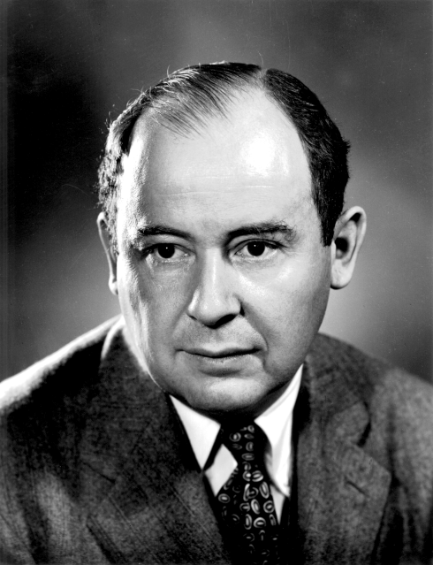
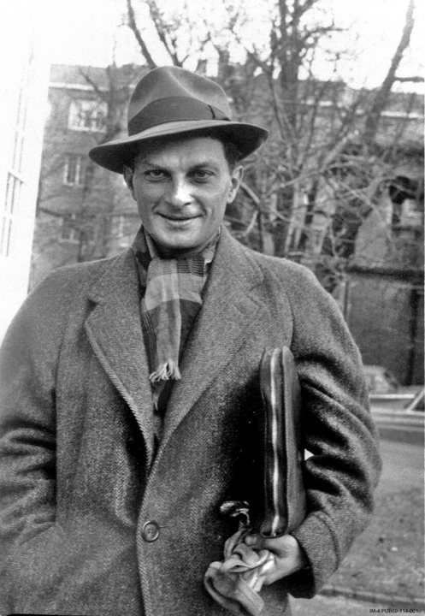

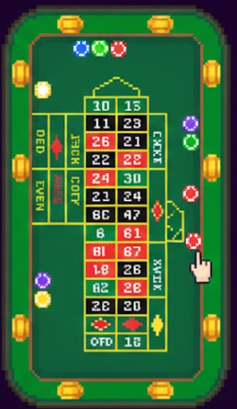
JOHN VON NEUMANN
STANISŁAW ULAM

Slide 4
APPLICATIONS
PHYSICS AND ENGINEERING
FINANCE
COMPUTER GRAPHICS
MACHINE LEARNING

Slide 5



EVER WONDERED HOW GAMES CREATE SUCH REALISTIC WORLDS IN THE FIRST PLACE?

Slide 6
REALISTIC WORLD?
When you play a game, the engine is basically working overtime behind the scenes—juggling light, shadows, reflections, and motion at lightning speed so the world feels real instead of fake. Every single frame.
01
it’s making thousands of tiny decisions: Where should this shadow fall? How shiny is that surface? How does the light bounce off this wall? You don’t notice any of this while playing—but without those nonstop calculations, the game world would instantly fall apart.
02

Slide 7


SIMULATING REALITY
03
Now here’s the twist: game engines like Unity turn into a playground for Monte Carlo ray tracing. What begins as game rendering becomes a visual experiment, where noise fades, samples increase, and images slowly converge—showing probability and realism in action, all on the same screen.

Slide 8
MONTE CARLO ?
MONTE CARLO RAY TRACING IS A RENDERING TECHNIQUE THAT USES RANDOM SAMPLING TO ESTIMATE HOW LIGHT IS TRANSPORTED IN A SCENE.

Slide 9
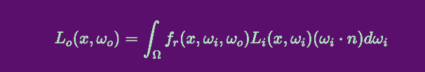
RENDERING EQUATION

Slide 10

SO WHAT ARE WE REALLY SOLVING?
LIGHT DOESN’T JUST HIT AN OBJECT ONCE — IT BOUNCES EVERYWHERE
EVERY PIXEL IS INFLUENCED BY COUNTLESS POSSIBLE LIGHT PATHS
REFLECTIONS, SHADOWS, AND COLOR ALL COME FROM THESE INTERACTIONS
WHY NOT JUST CALCULATE IT?
THERE ARE TOO MANY PATHS TO COUNT
LIGHT CAN BOUNCE FOREVER
SOLVING IT EXACTLY WOULD TAKE… BASICALLY FOREVER
WHAT NOW ???
We estimate instead OF CALCULATE
FIRE RANDOM RAYS AND LET PROBABILITY DO THE WORK

Slide 11
WHAT IS SAMPLING?
GUESSING LIGHT THE SMART WAY
In Monte Carlo ray tracing, sampling means firing multiple random rays per pixel to estimate how light behaves in a scene.
01
With few samples, images look noisy and unstable
With more samples, noise decreases and details become clearer
This follows the Law of Large Numbers: as the number of samples increases, the result converges toward the true value
02
03
Each ray is a guess — and the final pixel color is the average of many guesses.

Slide 12
SAMPLE COUNT (N)
=
NUMBER OF RAYS PER PIXEL
WHY NOT JUST INCREASE N THEN?
WELL, INCREASING N MEANS:
✔ IMPROVES IMAGE QUALITY (HIGHER PSNR, LOWER MSE)
✖ INCREASES RENDERING TIME ALMOST LINEARLY
THIS CREATES A QUALITY VS. PERFORMANCE TRADE-OFF

Slide 13
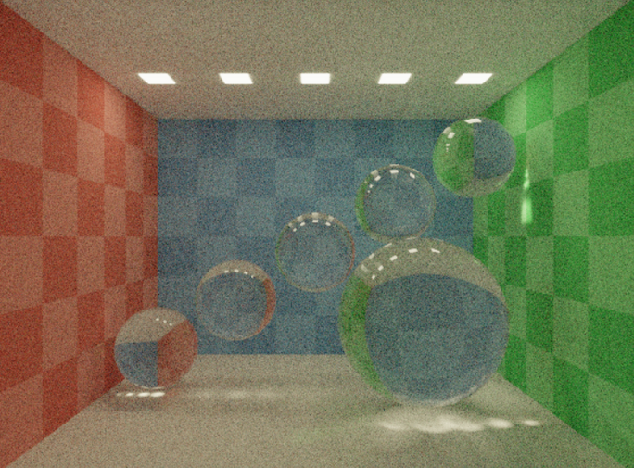
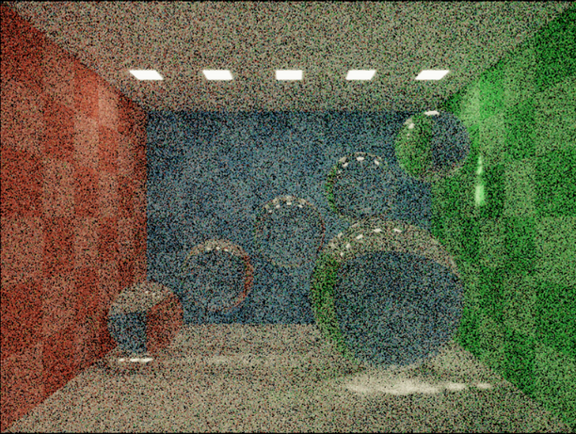
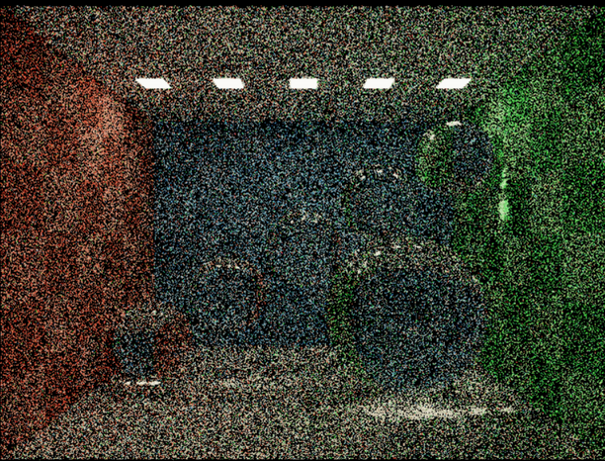
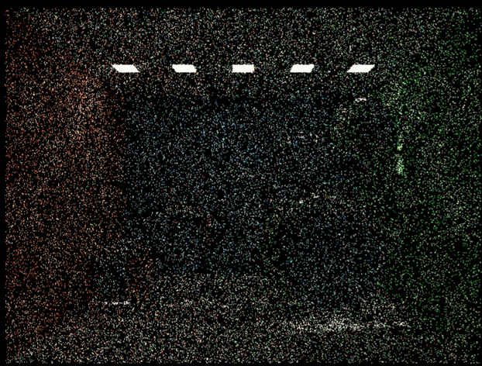
1024
128
32
8

Slide 14
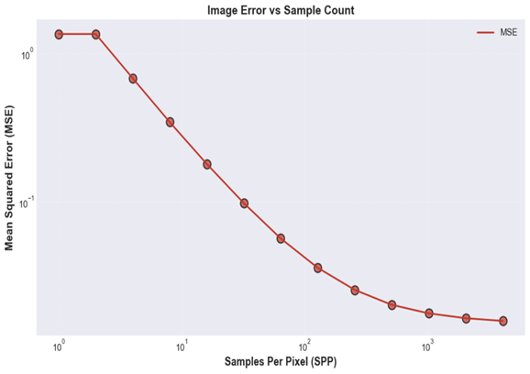
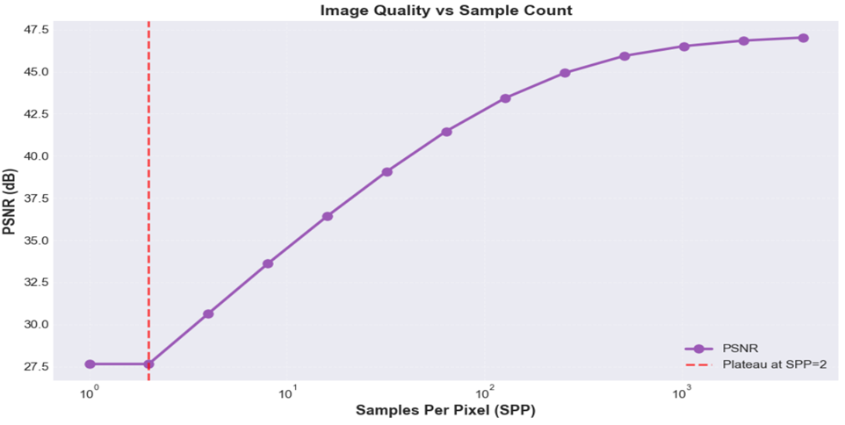
AS THE NUMBER OF SAMPLES PER PIXEL INCREASES, THE MEAN SQUARED ERROR DROPS STEADILY, SHOWING THAT THE IMAGE BECOMES LESS NOISY.
THIS DEMONSTRATES MONTE CARLO CONVERGENCE: MORE SAMPLES AVERAGE OUT RANDOMNESS, LEADING TO MORE ACCURATE AND STABLE RESULTS.
AS THE NUMBER OF SAMPLES PER PIXEL INCREASES,
PSNR (PEAK SIGNAL-TO-NOISE RATIO) RISES RAPIDLY, INDICATING IMPROVED IMAGE QUALITY.
AFTER A CERTAIN POINT, THE CURVE FLATTENS, SHOWING DIMINISHING RETURNS WHERE EXTRA SAMPLES ADD LITTLE VISIBLE IMPROVEMENT.

Slide 15
WE KEEP MENTIONING NOISE
WHERE DOES NOISE COME FROM?
MONTE CARLO RENDERING USES RANDOM RAYS
EACH RAY IS A GUESS ABOUT HOW LIGHT BEHAVES
DIFFERENT GUESSES PRODUCE SLIGHTLY DIFFERENT RESULTS
WHAT WE SEE ON SCREEN
WHEN GUESSES DISAGREE, PIXELS DON’T MATCH
THIS DISAGREEMENT APPEARS AS GRAIN OR NOISE
THE REAL REASON
THIS RANDOMNESS IS CALLED VARIANCE
LOW SAMPLES → HIGH VARIANCE → NOISY IMAGE
MORE SAMPLES LET THE GUESSES AVERAGE OUT, REDUCING NOISE

Slide 16
CONVERGENCE IN MONTE CARLO
EACH PIXEL COLOR STARTS AS A ROUGH GUESS
THAT GUESS IS BASED ON A SMALL NUMBER OF RANDOM RAYS
WitH FEW RAYS, THE RESULT CHANGES A LOT BETWEEN RENDERS
AS MORE RAYS ARE ADDED, THE AVERAGE CHANGES LESS AND LESS
EVENTUALLY , ADDING NEW SAMPLES BARELY CHANGES THE IMAGE
WHEN RESULTS STOP CHANGING AND SETTLE TO A FINAL VALUE,
THIS BEHAVIOR IS CALLED CONVERGENCE

Slide 17
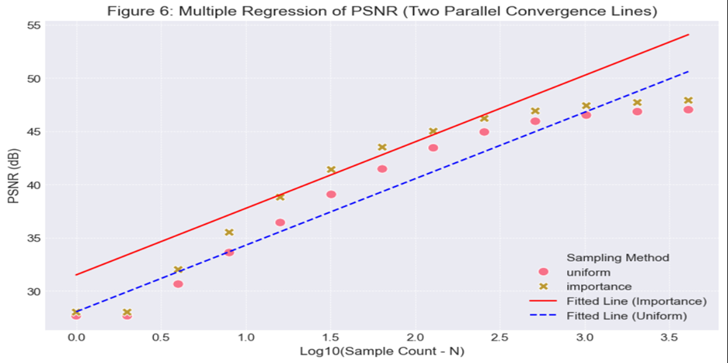
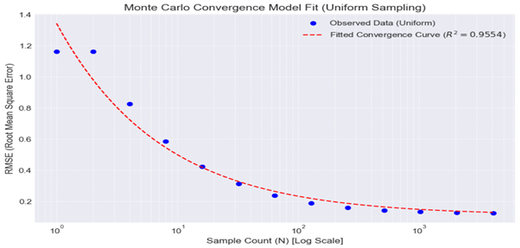
AS N INCREASES, RMSE DECREASES, SHOWING THAT UNIFORM SAMPLING CONVERGES TOWARD THE CORRECT RESULT, WITH ERROR DROPPING PREDICTABLY AS MORE SAMPLES ARE TAKEN.
IMPORTANCE SAMPLING ACHIEVES HIGHER PSNR FOR THE SAME N (THE LINE IS ABOVE THE UNIFORM ONE), MEANING IT CONVERGES FASTER IN TERMS OF PER-SAMPLE EFFICIENCY. HOWEVER, SINCE THE LINES ARE PARALLEL, THE RATE OF CONVERGENCE IS THE SAME FOR BOTH

Slide 18
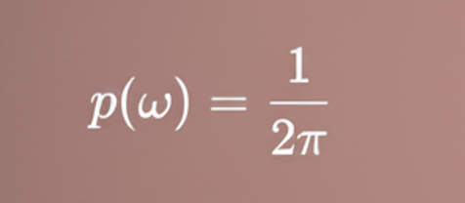
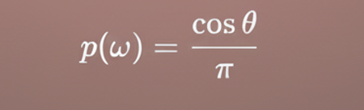
SAMPLING STRATEGIES
Uniform Sampling
Importance Sampling
THINK OF THIS AS SPRAYING RAYS EVERYWHERE EQUALLY.
RAYS ARE FIRED IN ALL DIRECTIONS
SIMPLE AND UNBIASED
BUT MANY RAYS MISS IMPORTANT LIGHT PATHS, WASTING EFFORT AND CREATING MORE NOISE
THIS IS AIMING WHERE THE LIGHT
ACTUALLY MATTERS.
Rays fOCUS ON DIRECTIONS WITH HIGHER LIGHT CONTRIBUTION
EACH SAMPLE CARRIES MORE USEFUL INFORMATION
LESS NOISE PER SAMPLE → CLEANER IMAGES FASTER
SAME RANDOMNESS, BUT MUCH SMARTER USE OF IT.

Slide 19
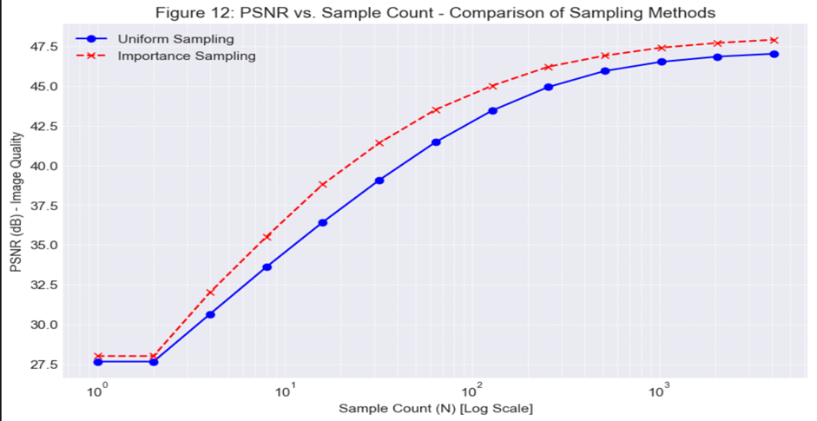
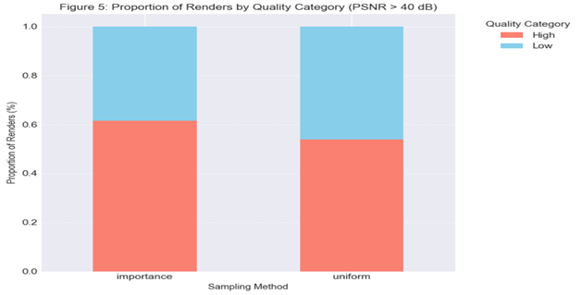
THE EFFECT OF THE SAMPLING METHOD IS STATISTICALLY SIGNIFICANT (P=0.1280).
IMPORTANCE SAMPLING PROVIDES A MEAN ADVANTAGE OF 1.3198 DB OVER UNIFORM.
And tHESE GRAPHS SHOW HOW DIFFERENT SAMPLING STRATEGIES REDUCE NOISE AT DIFFERENT RATES.
TO COMPARE DIFFERENT SAMPLING OR RENDERING METHODS

Slide 20
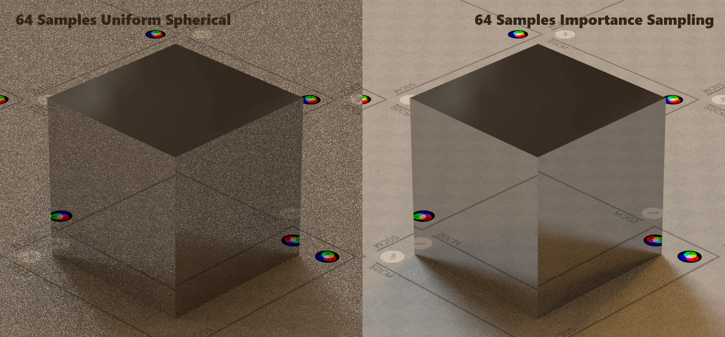
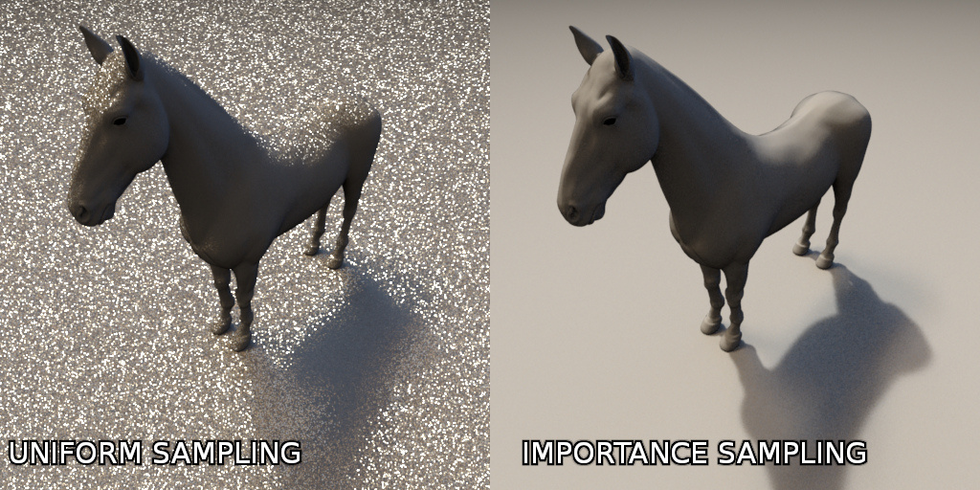

Slide 21
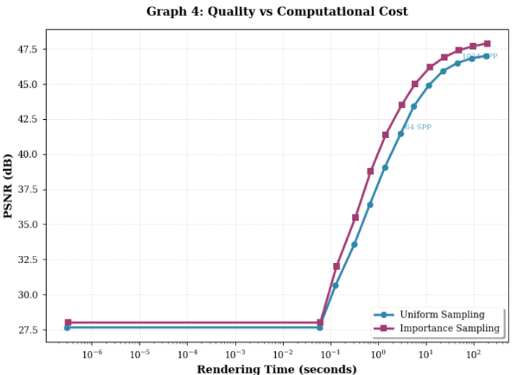
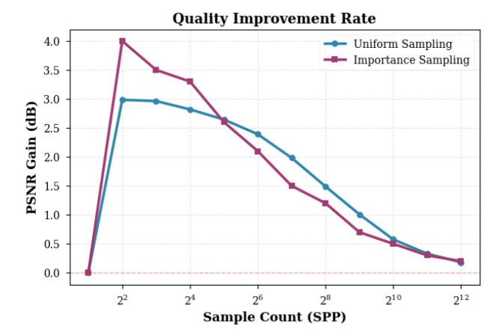
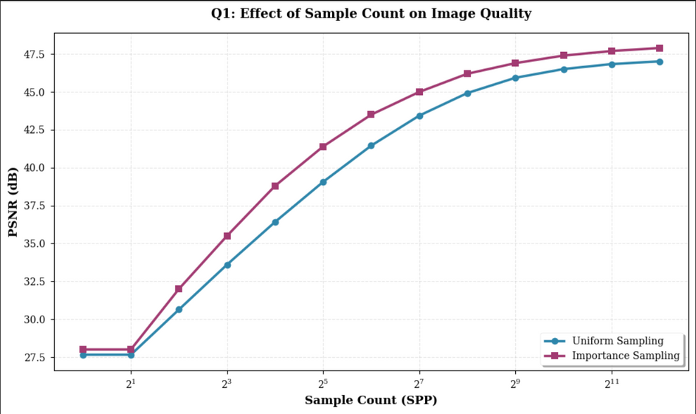

Slide 22
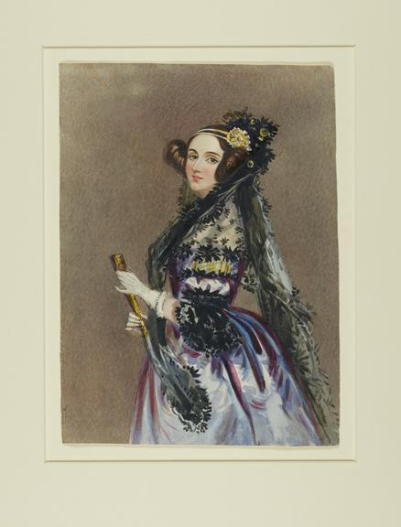
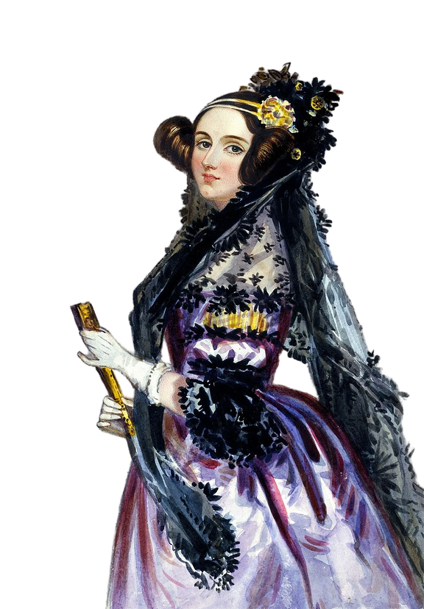
ADA LOVELACE
Our team name is inspired by NVIDIA’s Ada Lovelace GPU architecture, which powers modern RTX graphics cards (RTX 3000 and RTX 4000 series). This architecture is specifically designed to accelerate ray tracing, Monte Carlo sampling, and AI-based denoising—the exact core technologies studied in our project.
The architecture itself is named after Ada LOVELACE, THE 19TH-CENTURY MATHEMATICIAN WIDELY REGARDED AS THE FIRST COMPUTER PROGRAMMER. SHE ENVISIONED MACHINES CAPABLE OF PERFORMING COMPLEX CALCULATIONS LONG BEFORE MODERN COMPUTERS EXISTED.

Slide 23




MONTE CARLO RENDERING DOESN’T REMOVE RANDOMNESS — IT USES PROBABILITY TO CONTROL IT.
MORE SAMPLES CALM THE NOISE, SMARTER SAMPLING BENDS THE ODDS TOWARD IMPORTANT LIGHT. WHEN PROBABILITY IS USED WISELY, RANDOMNESS TURNS INTO REALISM—AND THAT’S THE SECRET BEHIND FAST, BELIEVABLE GRAPHICS IN GAMES AND MUCH MORE. 🎮✨

Slide 24

DONE BY ->
HABIBA KHALED
MARYAM REFAAT
NANCY ASHRAF
EBRAAM ASHRAF
MUHAMMED KHALED

Slide 25


THANKYOU

